Slide 1
Ezy-Furnish
Where Style Meets Comfort

Slide 2
The Growing Problem in the Furniture Industry
Finding high-quality, affordable furniture with fast delivery is a common challenge for modern homeowners.

Slide 3
Limited Variety & Availability
"Consumers often struggle to find a wide variety of styles, colors, and types of furniture in one place, leading to frustration and wasted time. When shopping for specific items like sofas or dining tables, people often can't find the perfect match for their preferences and budget on a single platform."
Confusion in Pricing & Value
"Price comparison is difficult when shopping for furniture online. Shoppers face challenges when trying to understand the true value of products due to inconsistent pricing, lack of product details, and variation in quality among sellers."
Difficulty in Trusting Online Sellers
"Online furniture shoppers are often hesitant to make a purchase due to a lack of detailed product information, customer reviews, and high-quality images. Without the ability to physically inspect the furniture, customers struggle to trust online retailers."

Slide 4
Limited Customization Options
"Furniture buyers looking for customized solutions—such as specific sizes, finishes, or materials—are often disappointed. The inability to personalize furniture according to personal needs and preferences is a major limitation in the current market.“
Long Delivery Times & High Shipping Costs
"Furniture shoppers often face long wait times for delivery and high shipping costs, which add frustration to the purchasing process. In many cases, delivery times can stretch to weeks, and customers are forced to pay extra fees for shipping.“
Lack of Post-Purchase Support
"Once the purchase is made, many customers feel unsupported. Lack of services like easy returns, product assembly, and customer support leads to dissatisfaction and increased return rates."

Slide 5
Market Size & Growth: "The online furniture market is expected to reach $45 billion by 2027, growing at a CAGR (Compound Annual Growth Rate) of 15%. Yet, over 60% of customers report dissatisfaction with the variety and quality of furniture available online.“
Customer Behavior: "A survey found that 40% of customers avoid buying furniture online because they don’t trust the product quality without seeing it in person.“
Delivery & Shipping: "Reports show that 30% of customers have abandoned furniture purchases due to high shipping fees or unclear delivery timelines."

Slide 6
Our Solution
Wide Selection of Furniture
"Our marketplace brings together a diverse range of furniture from various trusted sellers in one place. Whether you're looking for modern, classic, or customizable pieces, we ensure you have a wide array of options to suit every style and budget."
Transparent Pricing & Product Comparison
"We simplify the purchasing decision by offering clear pricing with no hidden fees. Customers can compare products based on features, prices, and customer reviews, making it easy to find the best value for their money."
Customer Trust with Detailed Information
"Our platform provides high-quality images, in-depth product descriptions, and customer reviews to give buyers a better understanding of the quality of the products they are purchasing. Transparent seller ratings help build trust and confidence in the shopping experience."

Slide 7
Customization Options
"We offer customizable furniture, allowing customers to adjust dimensions, choose finishes, and select materials to perfectly match their needs and home décor preferences."
Fast, Affordable Shipping & Delivery
"We work with trusted logistics partners to offer fast delivery at competitive prices, with clear timelines and real-time tracking. Our platform allows customers to view shipping costs upfront to avoid surprises."
Excellent Post-Purchase Support
"We offer post-purchase support, including easy returns, product assembly services, and a customer support team ready to assist with any inquiries. Our commitment to customer satisfaction ensures a seamless experience from purchase to delivery."

Slide 8
Market Opportunity
Rising Demand for Online Shopping
"Online shopping is increasingly becoming the preferred method for purchasing furniture. Consumers are now looking for convenience, wide variety, and easy price comparison—traits that online marketplaces provide. In 2024, 60% of furniture purchases in the U.S. were made online, and this trend is expected to continue growing.“
Increasing Interest in Customization
"There is a growing trend for personalized and customizable furniture. Consumers want more control over the design and functionality of their furniture to match their unique needs and home décor. Our marketplace taps into this demand by offering customizable options on several products."

Slide 9

The global furniture market is currently valued at approximately $500 billion, with the online segment expected to grow rapidly. The online furniture market alone is projected to reach $45 billion by 2027, growing at a compound annual growth rate (CAGR) of 15%.

Slide 10
Sustainability Trends
"Sustainability is becoming a key factor for many consumers when choosing furniture. The shift towards eco-friendly and sustainable furniture materials is driving growth in the market. Our platform supports this trend by offering eco-conscious products from sustainable brands.“
Target Audience Demographics
"Our primary audience includes middle to high-income consumers aged 25-50, who are tech-savvy and prefer shopping online for home essentials. This demographic is increasingly seeking quality, convenience, and affordability when purchasing furniture."

Slide 11
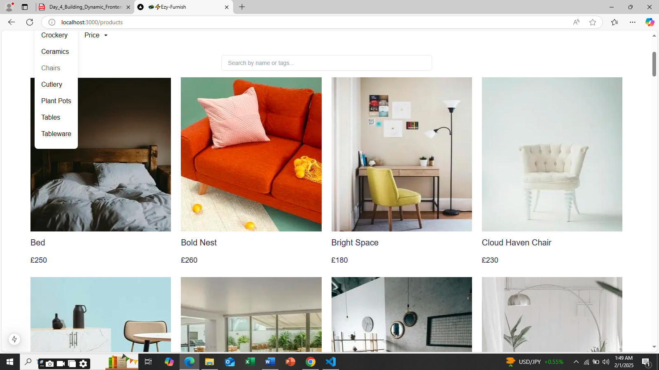
User-Friendly Interface
"Our platform is designed with the user in mind, offering an intuitive and seamless browsing experience. Customers can easily navigate through different furniture categories, filter based on preferences (price, material, size, etc.), and quickly find what they’re looking for."

Slide 12
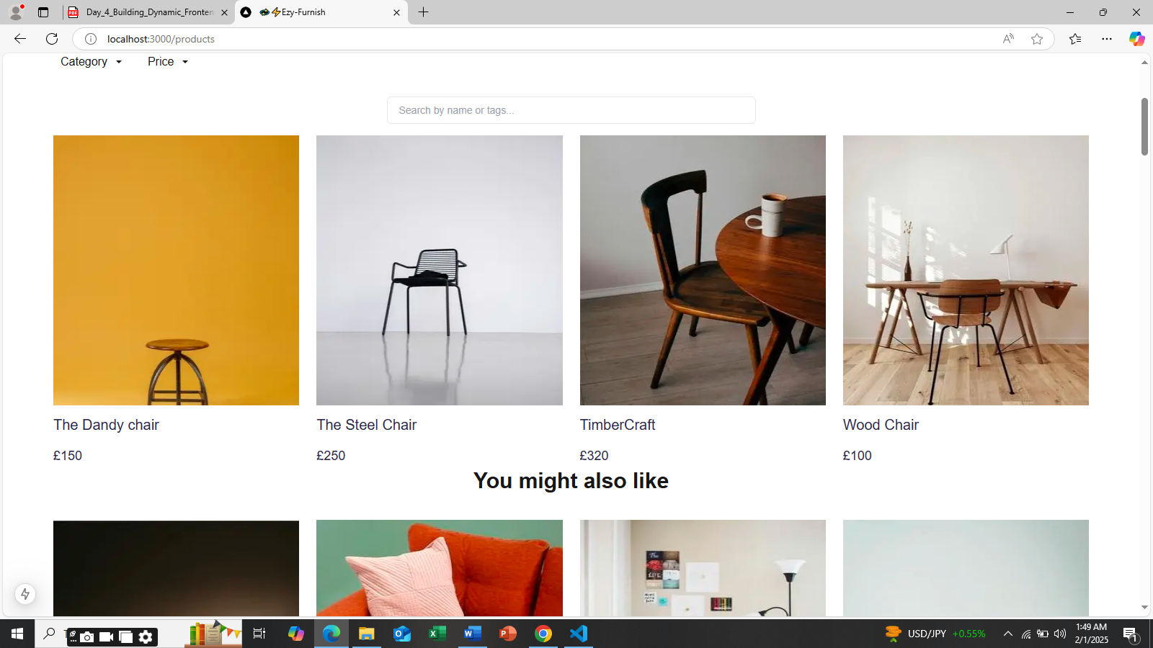
Wide Range of Furniture Categories
"We offer a broad selection of furniture for every room in the home: living room, bedroom, office, dining room, and outdoor furniture. Each category is filled with a curated selection from multiple trusted sellers, ensuring variety and quality."

Slide 13
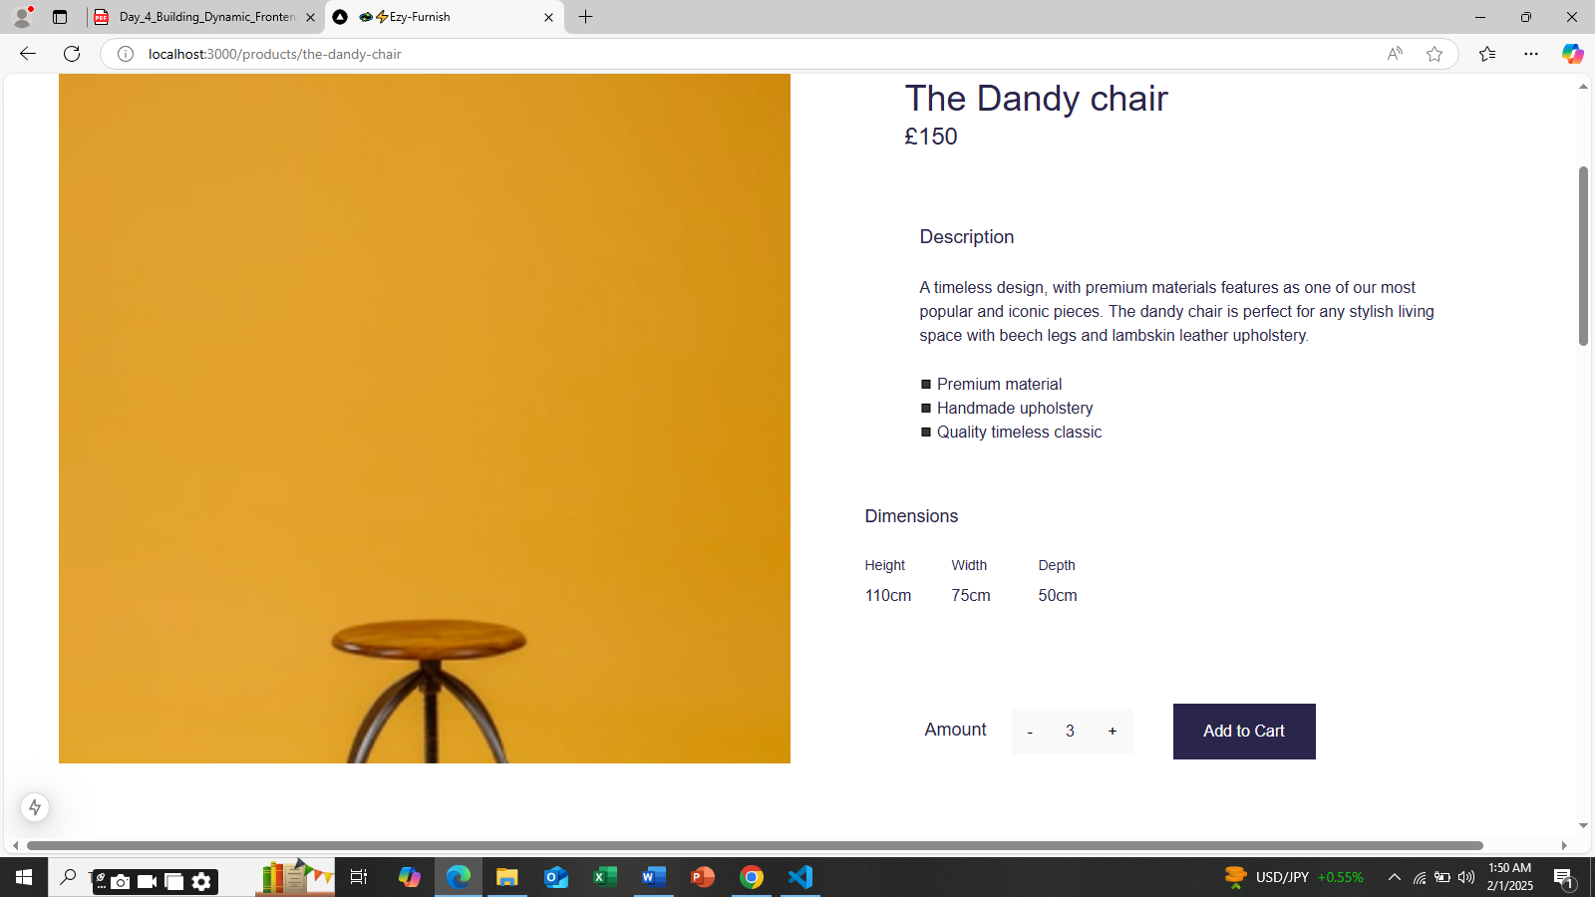
Clear Product Information & Reviews
"Each product page includes high-quality images, detailed descriptions, dimensions, and materials, giving customers the information they need to make informed decisions.

Slide 14
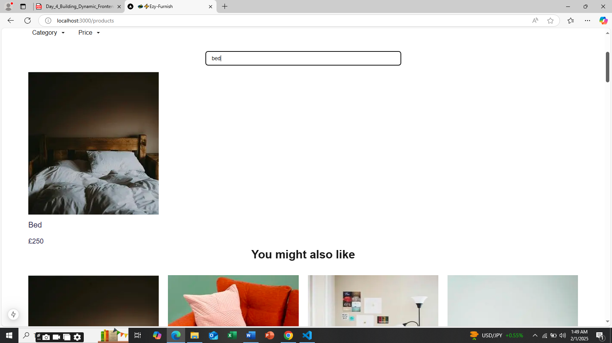
Advanced Search & Filter Options
"Our platform’s advanced search functionality lets customers filter by multiple factors—price, room type, style, material, color, and more—helping them find the perfect piece in seconds. This makes shopping quick and hassle-free."

Slide 15
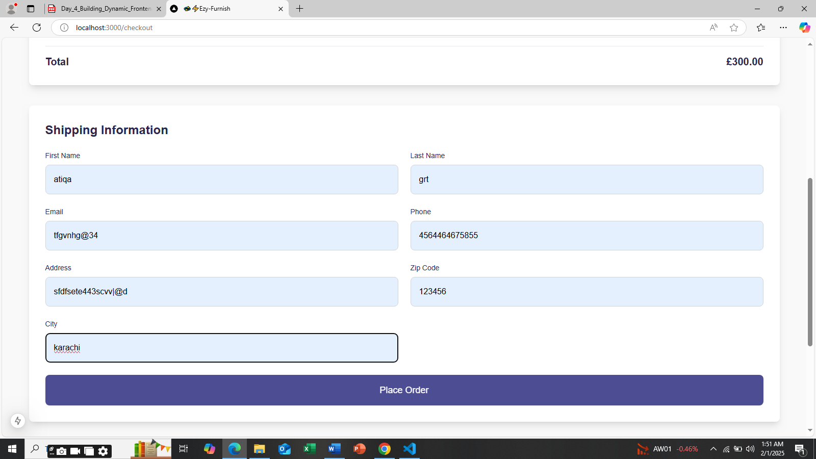
Seamless Checkout & Secure Payment
"We offer a seamless, secure checkout process with various payment options, including credit/debit cards, e-wallets, and Buy Now, Pay Later options. Our platform ensures all transactions are safe and easy."

Slide 16
Revenue Generation & Sustainability
"According to industry standards, commission-based revenue models in e-commerce generate around 15-20% of total revenue for platforms like ours.
"Subscription models for marketplace platforms have seen up to 40% annual growth in recent years, particularly in the furniture and home décor sectors."

Slide 17
Commission-Based Model
Our marketplace generates revenue primarily through commissions on sales. We charge a percentage of each sale made through our platform by third-party sellers. This allows us to scale while keeping upfront costs low for both sellers and customers

Slide 18
Subscription Fees for Sellers
We offer subscription plans for furniture brands and individual sellers to list their products on our platform. These plans are tiered based on the number of listings, promotional features, and visibility provided to the sellers, ensuring consistent revenue for our marketplace.

Slide 19
Advertising & Featured Listings
We provide advertising and featured listing options to sellers who want to increase visibility. This allows brands to pay for higher placement in search results and product categories, driving more traffic to their products and increasing our revenue.

Slide 20
Shipping & Handling Fees
We charge a small shipping and handling fee for deliveries through our platform. This fee ensures that we can offer timely, reliable shipping while covering part of the logistical costs. Transparent pricing for shipping is clearly communicated to customers before checkout.

Slide 21
Premium Services for Customers
We offer premium services to customers, such as exclusive discounts, early access to sales, and priority customer support. These services are available through a subscription model or pay-per-service.

Slide 22
Marketing Strategy
Targeted Digital Advertising
"We will use paid digital ads across Google, Facebook, Instagram, and Pinterest to reach our target audience. These platforms allow us to target specific demographics (age, interests, location) to maximize ad spend and drive high-quality traffic to our platform."
Influencer & Affiliate Marketing
"Partnering with influencers and bloggers in the home décor and lifestyle space will help us build brand awareness. These influencers will create content around our marketplace and drive traffic through affiliate links, earning commissions on sales they generate."

Slide 23
Email Marketing Campaigns
"According to HubSpot, businesses that use email marketing see a 3800% return on investment (ROI) for every dollar spent.“
"We’ll build an email subscriber list through opt-in forms and incentivize sign-ups with discounts or exclusive content. Email marketing will allow us to nurture relationships with our customers, send personalized recommendations, offer exclusive promotions, and encourage repeat purchases."
Referral Program
"We’ll launch a referral program that rewards existing customers for referring friends and family to our marketplace. Each successful referral can earn rewards like discounts or cash credits toward future purchases."

Slide 24
Social Media Engagement & Community Building
"Engaging with our audience on platforms like Instagram and Facebook will help build a loyal community. We’ll showcase new furniture collections, share interior design inspiration, and host giveaways to keep the audience engaged and excited about our platform.“
Retargeting Ads & Remarketing
Research shows that retargeting ads can increase conversion rates by 150%
"We will use retargeting ads to re-engage users who have visited our platform but haven’t made a purchase yet. These ads will be displayed across different sites they visit to remind them of our products and offer incentives for them to complete their purchase."

Slide 25
Team
Atiqa Sheikh – Founder & CEO
As the Founder and CEO, Atiqa Sheikh is responsible for the vision, strategy, and overall direction of the marketplace. With a passion for furniture e-commerce and a strong interest in creating innovative solutions, Atiqa Sheikh is leading the development of this platform to meet customer needs in the furniture industry.

Slide 26
Financial Projections
Revenue Forecast (Year 1 - Year 3)
"We expect steady revenue growth as we scale and acquire more customers. In Year 1, we anticipate generating $29999 from our commission-based sales and seller subscriptions, gradually increasing to $2999 by Year 3 as we expand our seller base and grow our customer traffic."

Slide 27
Cost Breakdown
Operational Costs: "In the early stages, our main costs will include website development, marketing, and logistics. We estimate that operational costs will be $20000 in Year 1, gradually increasing as we expand.“
Marketing Expenses: "Marketing will be a key focus, and we plan to allocate 10% of our total revenue to digital ads, influencer partnerships, and content creation. Initial marketing costs are estimated to be $20000 in Year 1.“
Platform Maintenance & Development: "As we scale, we will continue to invest in platform updates and maintenance, estimated at $10000 annually to ensure a seamless user experience."

Slide 28
Profitability Timeline
We expect to break even by the end of Year 2, with profitability occurring in Year 3 as we grow our user base and reduce acquisition costs. By Year 3, we project a net profit of $50000.

Slide 29
Key Metrics for Success
We will measure success based on key metrics such as customer acquisition cost (CAC), customer lifetime value (CLTV), and monthly active users (MAUs). We anticipate a CLTV of $5000 and a CAC of $15000 by the end of Year 1.

Slide 30
Call to Action
Join Us in Building the Future of Furniture Shopping

Slide 31
Funding Request
We are seeking $5000 in funding to help us scale our platform, improve user experience, and expand our marketing efforts. These funds will be used for platform development, acquiring new customers, and building our operational infrastructure to meet growing demand.

Slide 32
Partnership Opportunities
We are also open to strategic partnerships with furniture brands, suppliers, and logistics companies that share our vision of transforming the furniture shopping experience. Partnering with us will provide access to a growing customer base and new sales channels

Slide 33
Support and Mentorship
We welcome the opportunity to work with industry experts and mentors who can help guide us through the challenges of scaling an e-commerce business. If you have expertise in furniture retail, logistics, or technology, we would love to collaborate.

Slide 34
Next Steps
Let’s schedule a meeting or call to discuss how we can collaborate. We are excited to move forward with the right partners and supporters to bring this vision to life.

Slide 35
Thank you
for taking the time to learn about our furniture marketplace. We’re excited about the potential and would love to share more details with you.

Slide 36
Q&A
We welcome any questions you may have. Feel free to ask about our marketplace, the team, or any other details you’d like to know more about.

